Slide 1


Key Features of Airbnb
Listings in NYC
What Makes an Airbnb More Popular?
Heather He
Godwin Silayo
Muhammad Zohaib Bin Jamil

Slide 2
Preview
Dataset explanation
Data

Slide 3
Preview
Dataset explanation
Data
Analysis
Location
Room Type
Minimum Nights
Pricing

Slide 4
Preview
Dataset explanation
Limitation of Analysis
Data
Analysis
Limitation
Location
Room Type
Minimum Nights
Pricing

Slide 5
Preview
Dataset explanation
Limitation of Analysis
Data
Analysis
Limitation
Summary
Location
Room Type
Minimum Nights
Pricing
Summarise Findings

Slide 6
Preview
Hosts
Airbnb
Guests
Dataset explanation
Limitation of Analysis
Data
Analysis
Limitation
Summary
Recommendation
Location
Room Type
Minimum Nights
Pricing
Summarise Findings

Slide 7
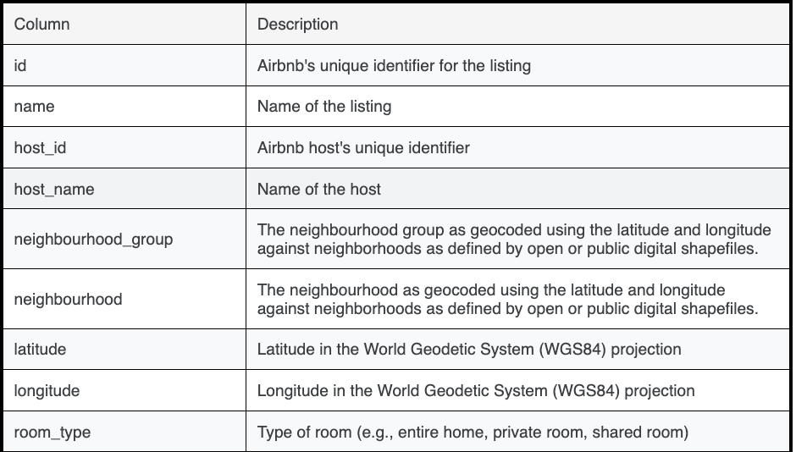
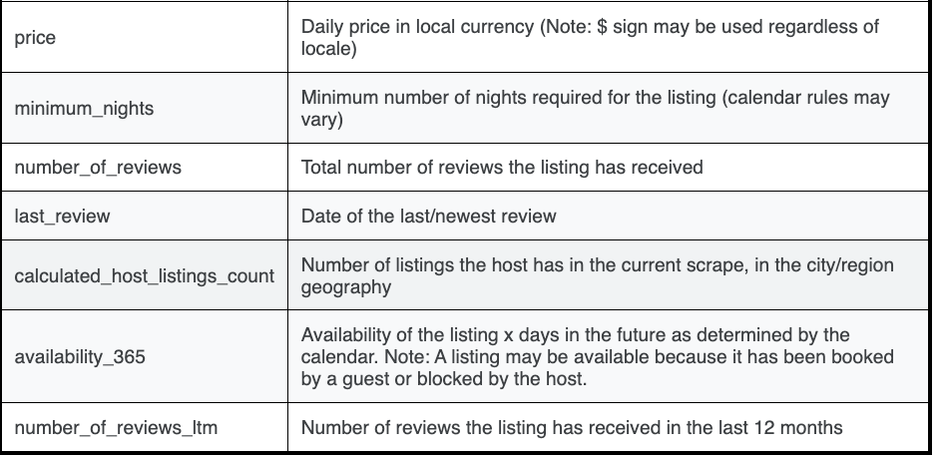
Dataset Overview
Kaggle
15 Variables
2000+ Rows

Slide 8

Location
Analysis

Slide 9
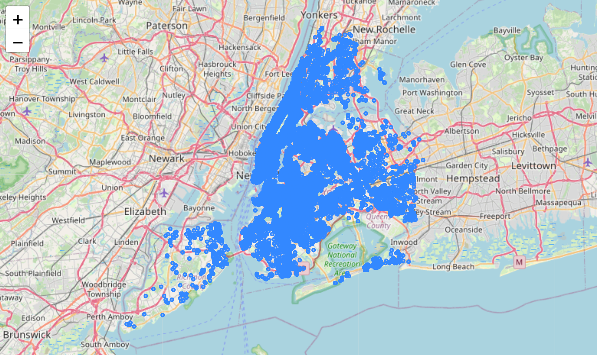
Listings Centered in South Central Manhattan and Brooklyn
MANHATTAN
BROOKLYN

Slide 10
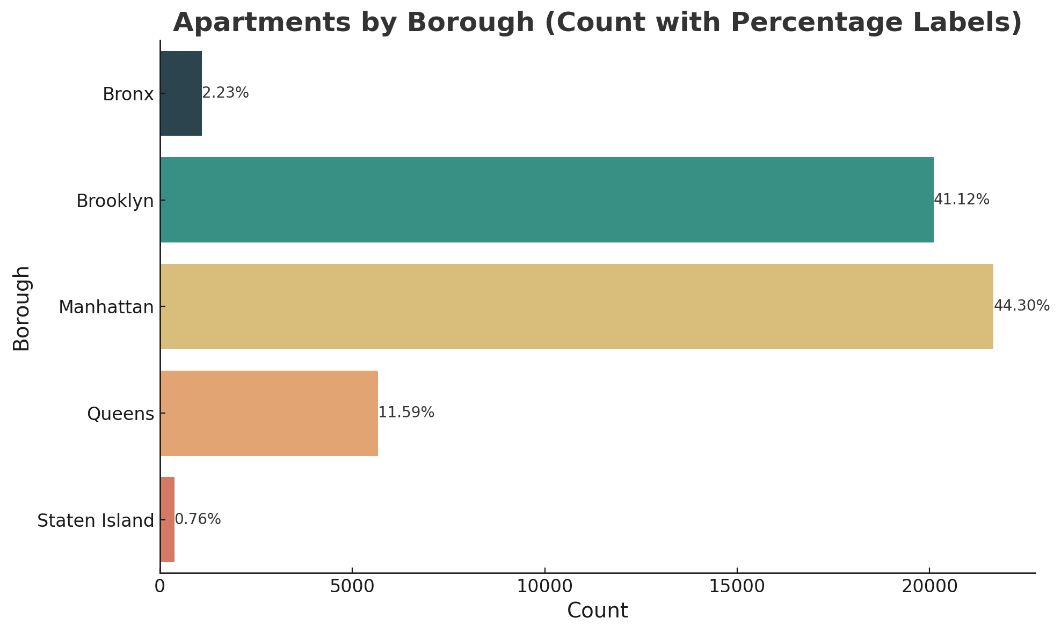
Brooklyn and Manhattan Account for Nearly 90% of Total Listings

Slide 11
Brooklyn and Manhattan Account for Nearly 90% of Total Listings

Slide 12
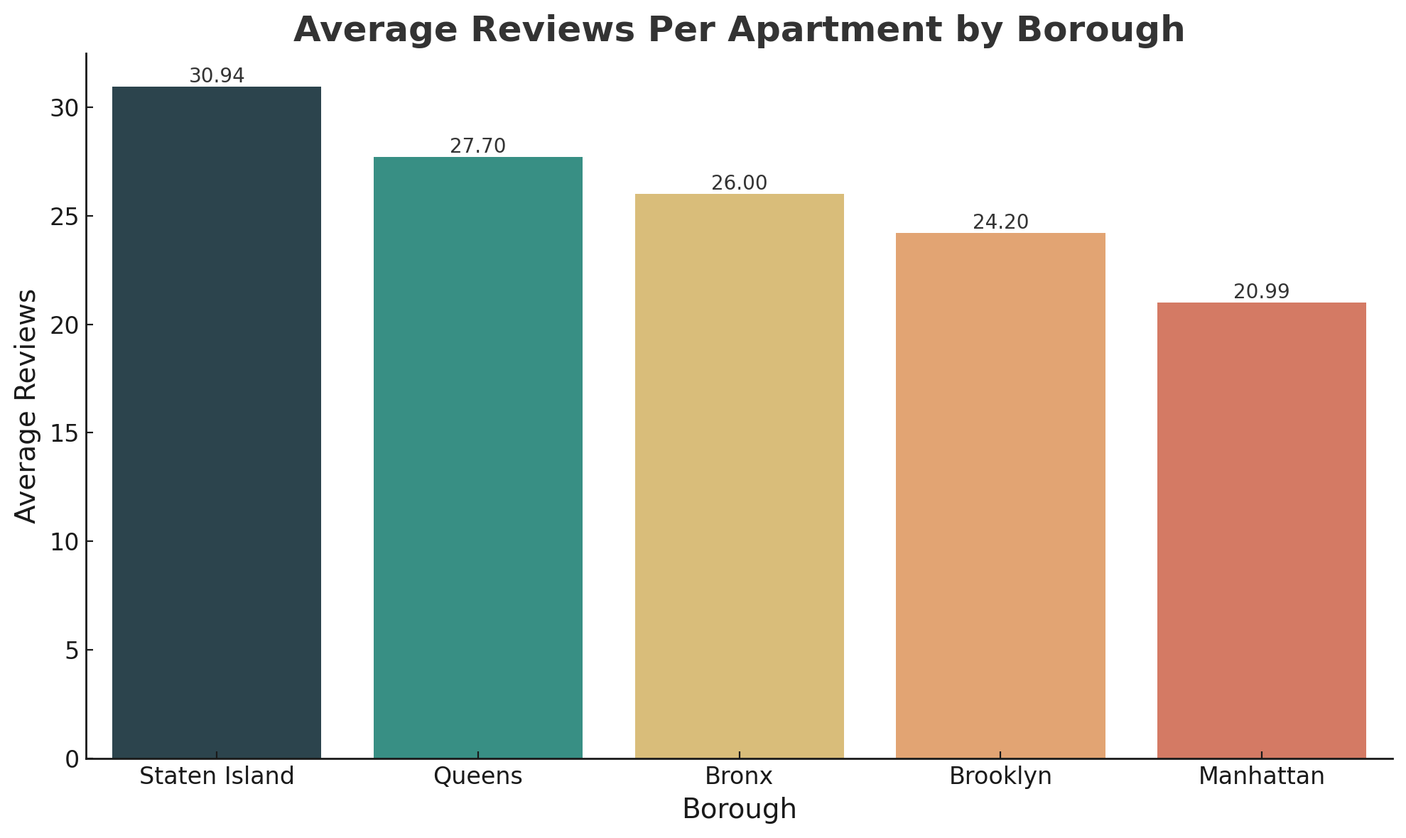
Staten Island Leads on Average Reviews by Nearly 20% Across Boroughs

Slide 13
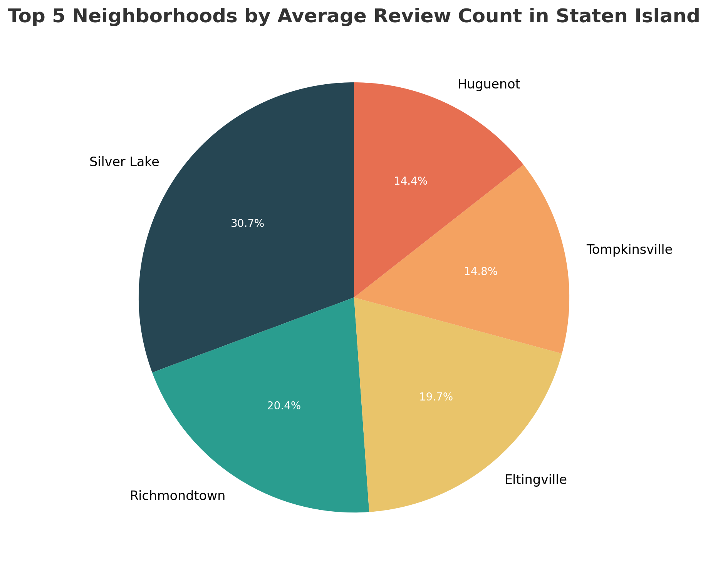
Silver Lake Garnered over 30% of All Reviews in Staten Island

Slide 14

Room Type Analysis

Slide 15
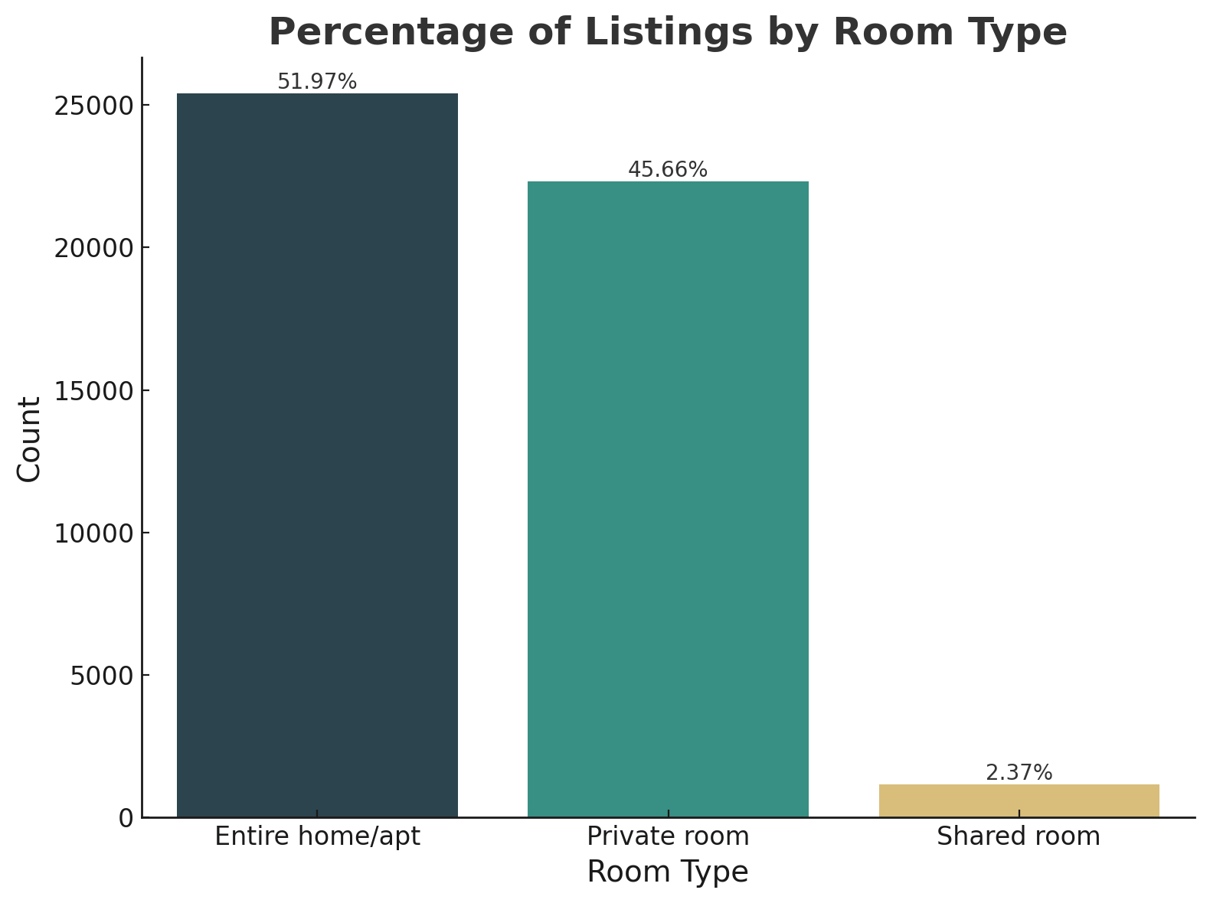
Entire Homes/Apartments Account for Majority Share at 51.97%

Slide 16
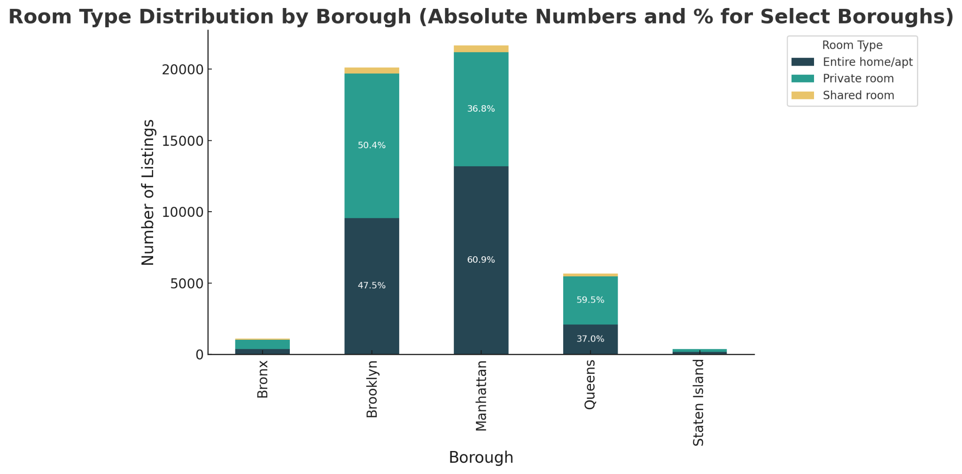
Private and Entire Room Types are Prevalent Across 5 Boroughs

Slide 17
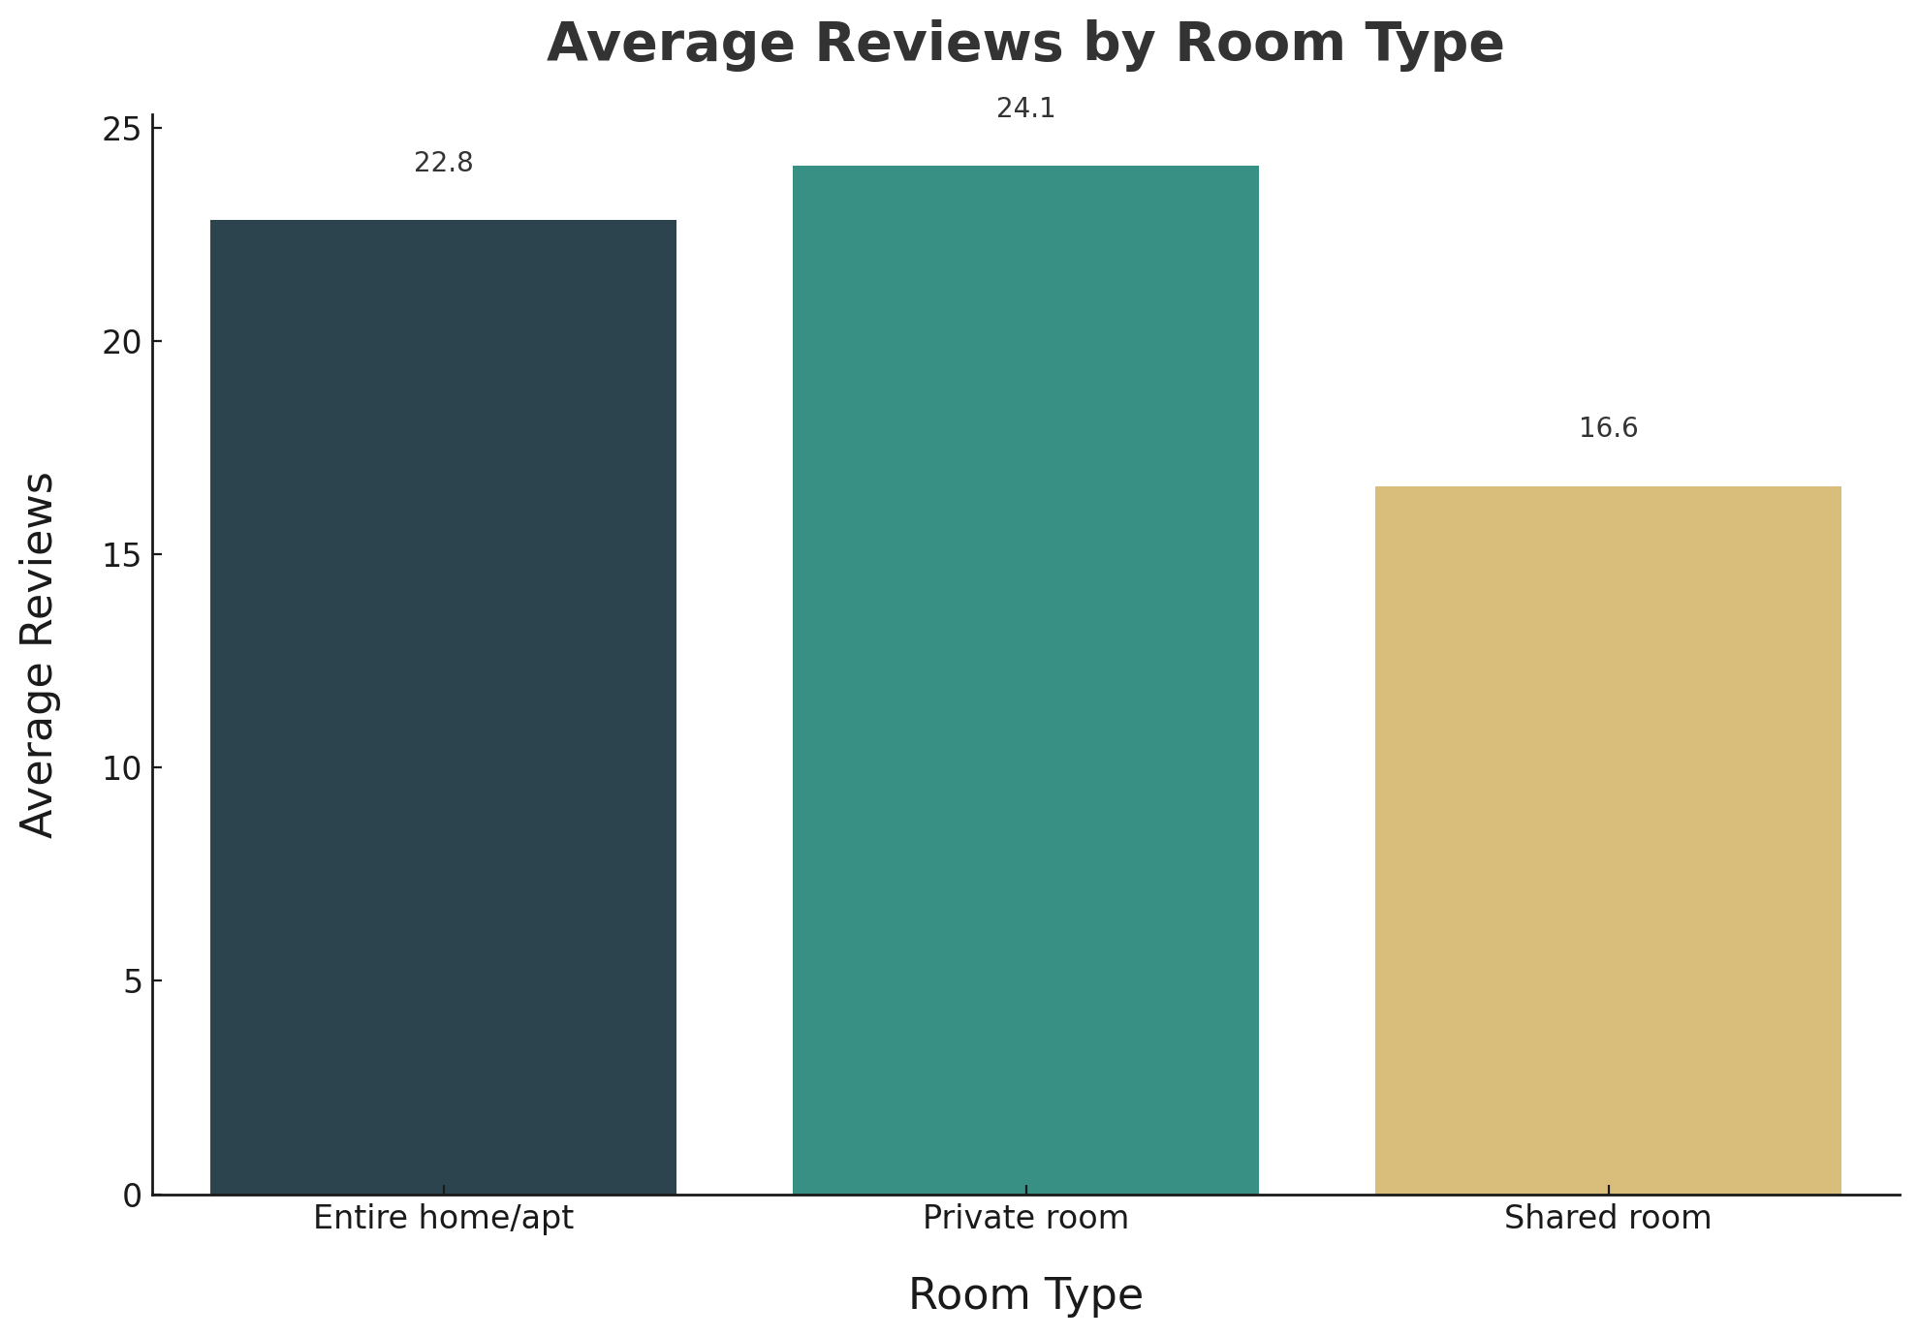
The Average Reviews of Private Room Type is Nearly 25

Slide 18
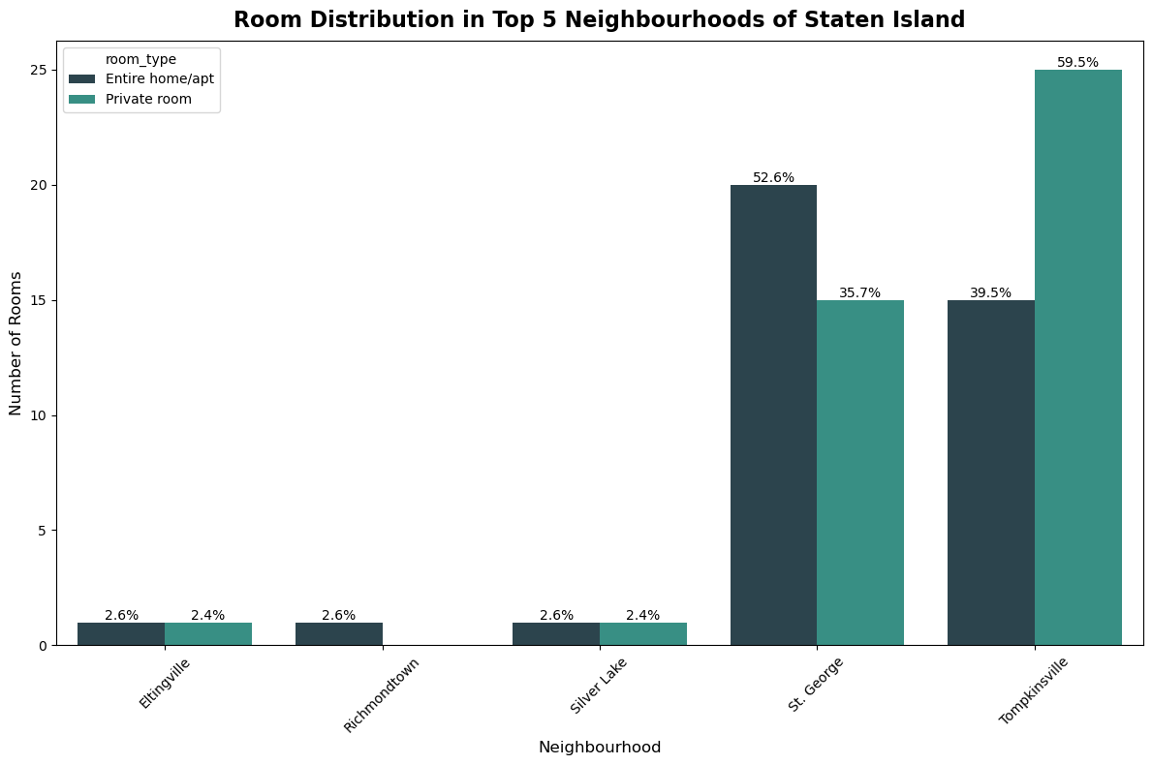
Silver Lake Neighborhood Has Nearly Equal Distribution

Slide 19

Pricing Analysis

Slide 20
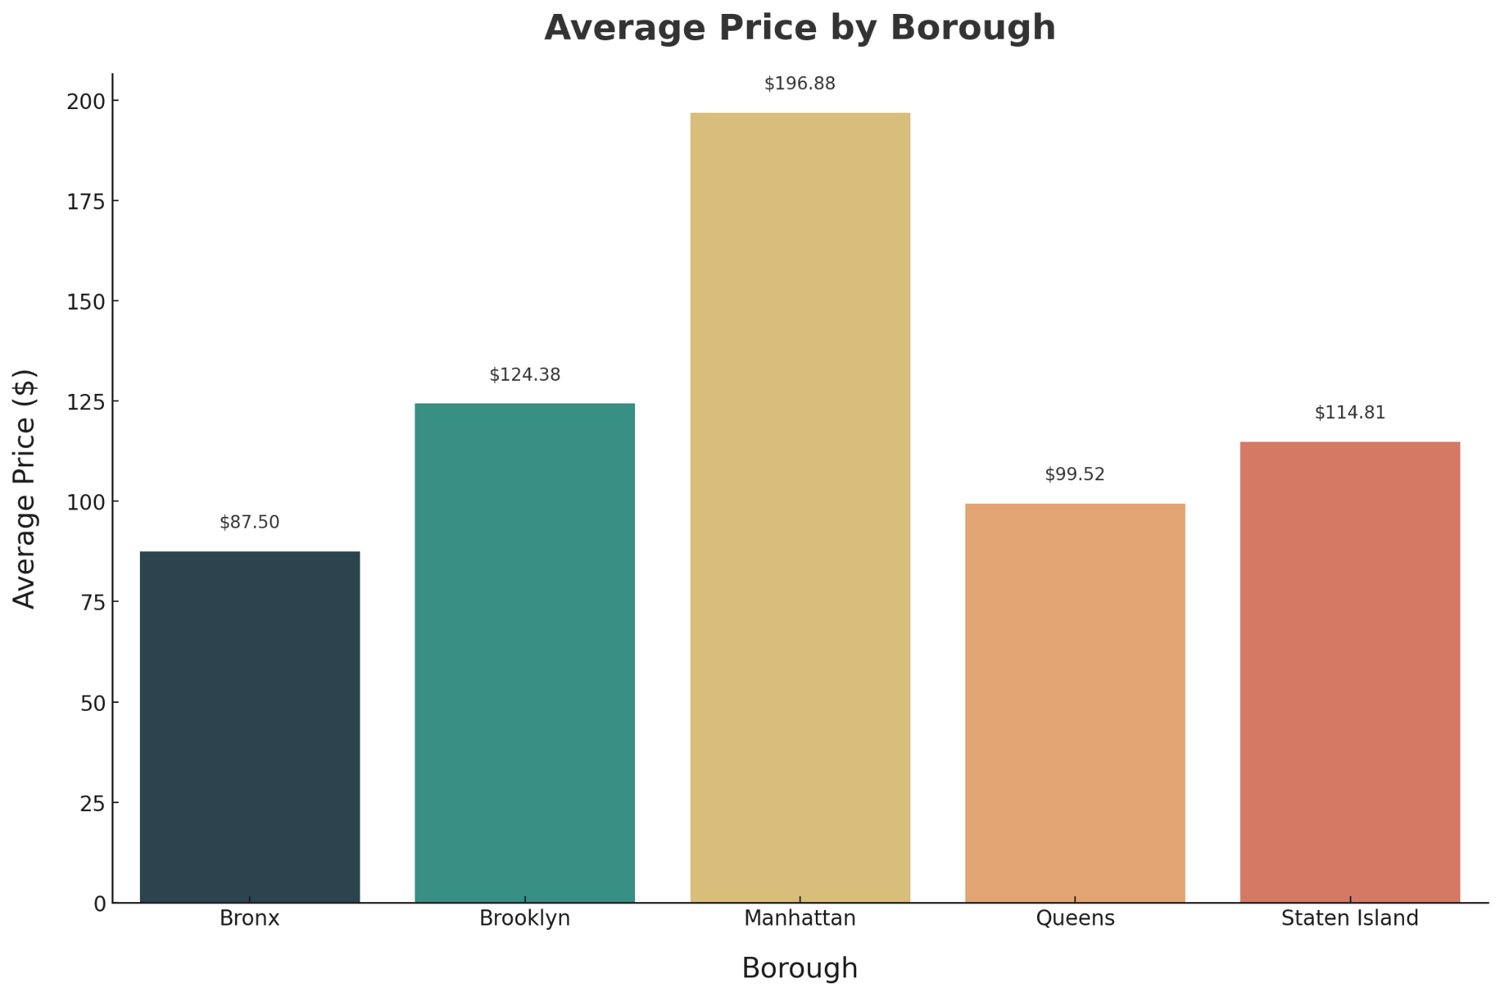
Manhattan Listings Command Close to $200 Average Price
29%

Slide 21
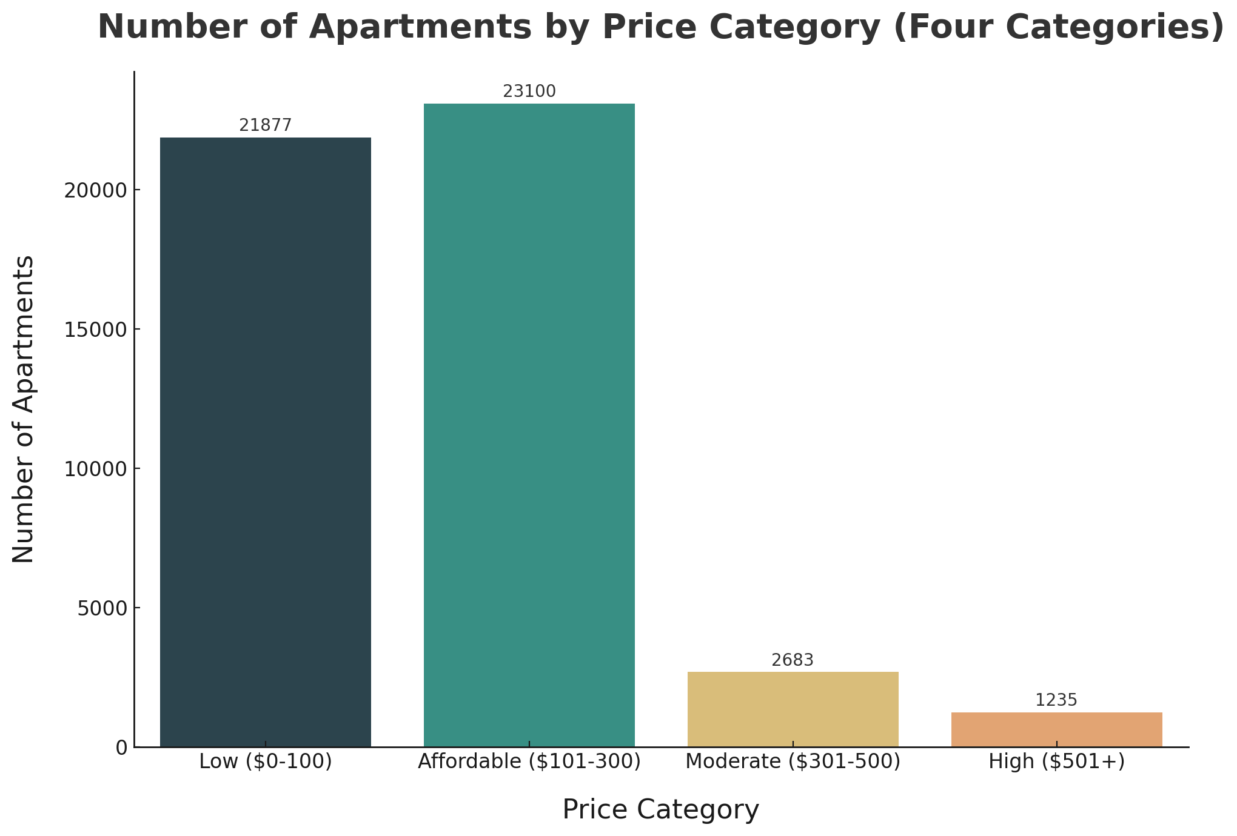
Mid-range Priced Apartments ($0–$300) Dominate Listings

Slide 22
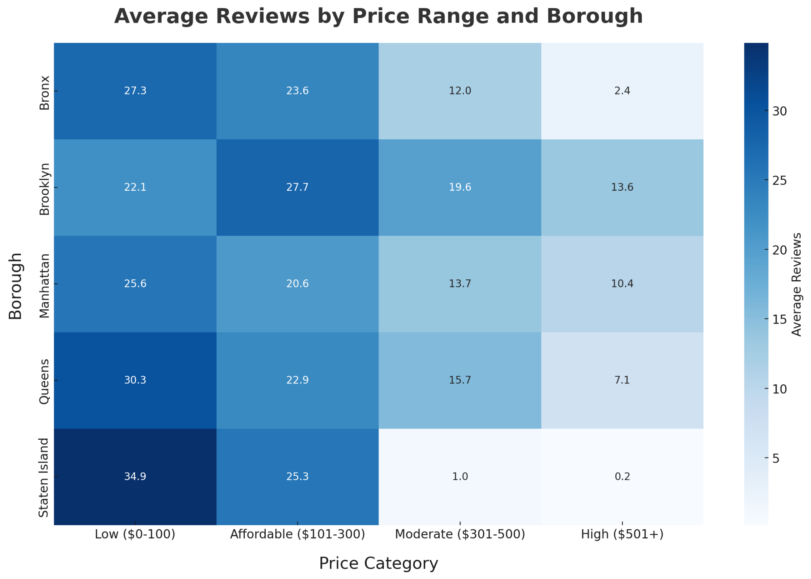
Lower-priced Listings Have Most Reviews Across Boroughs

Slide 23
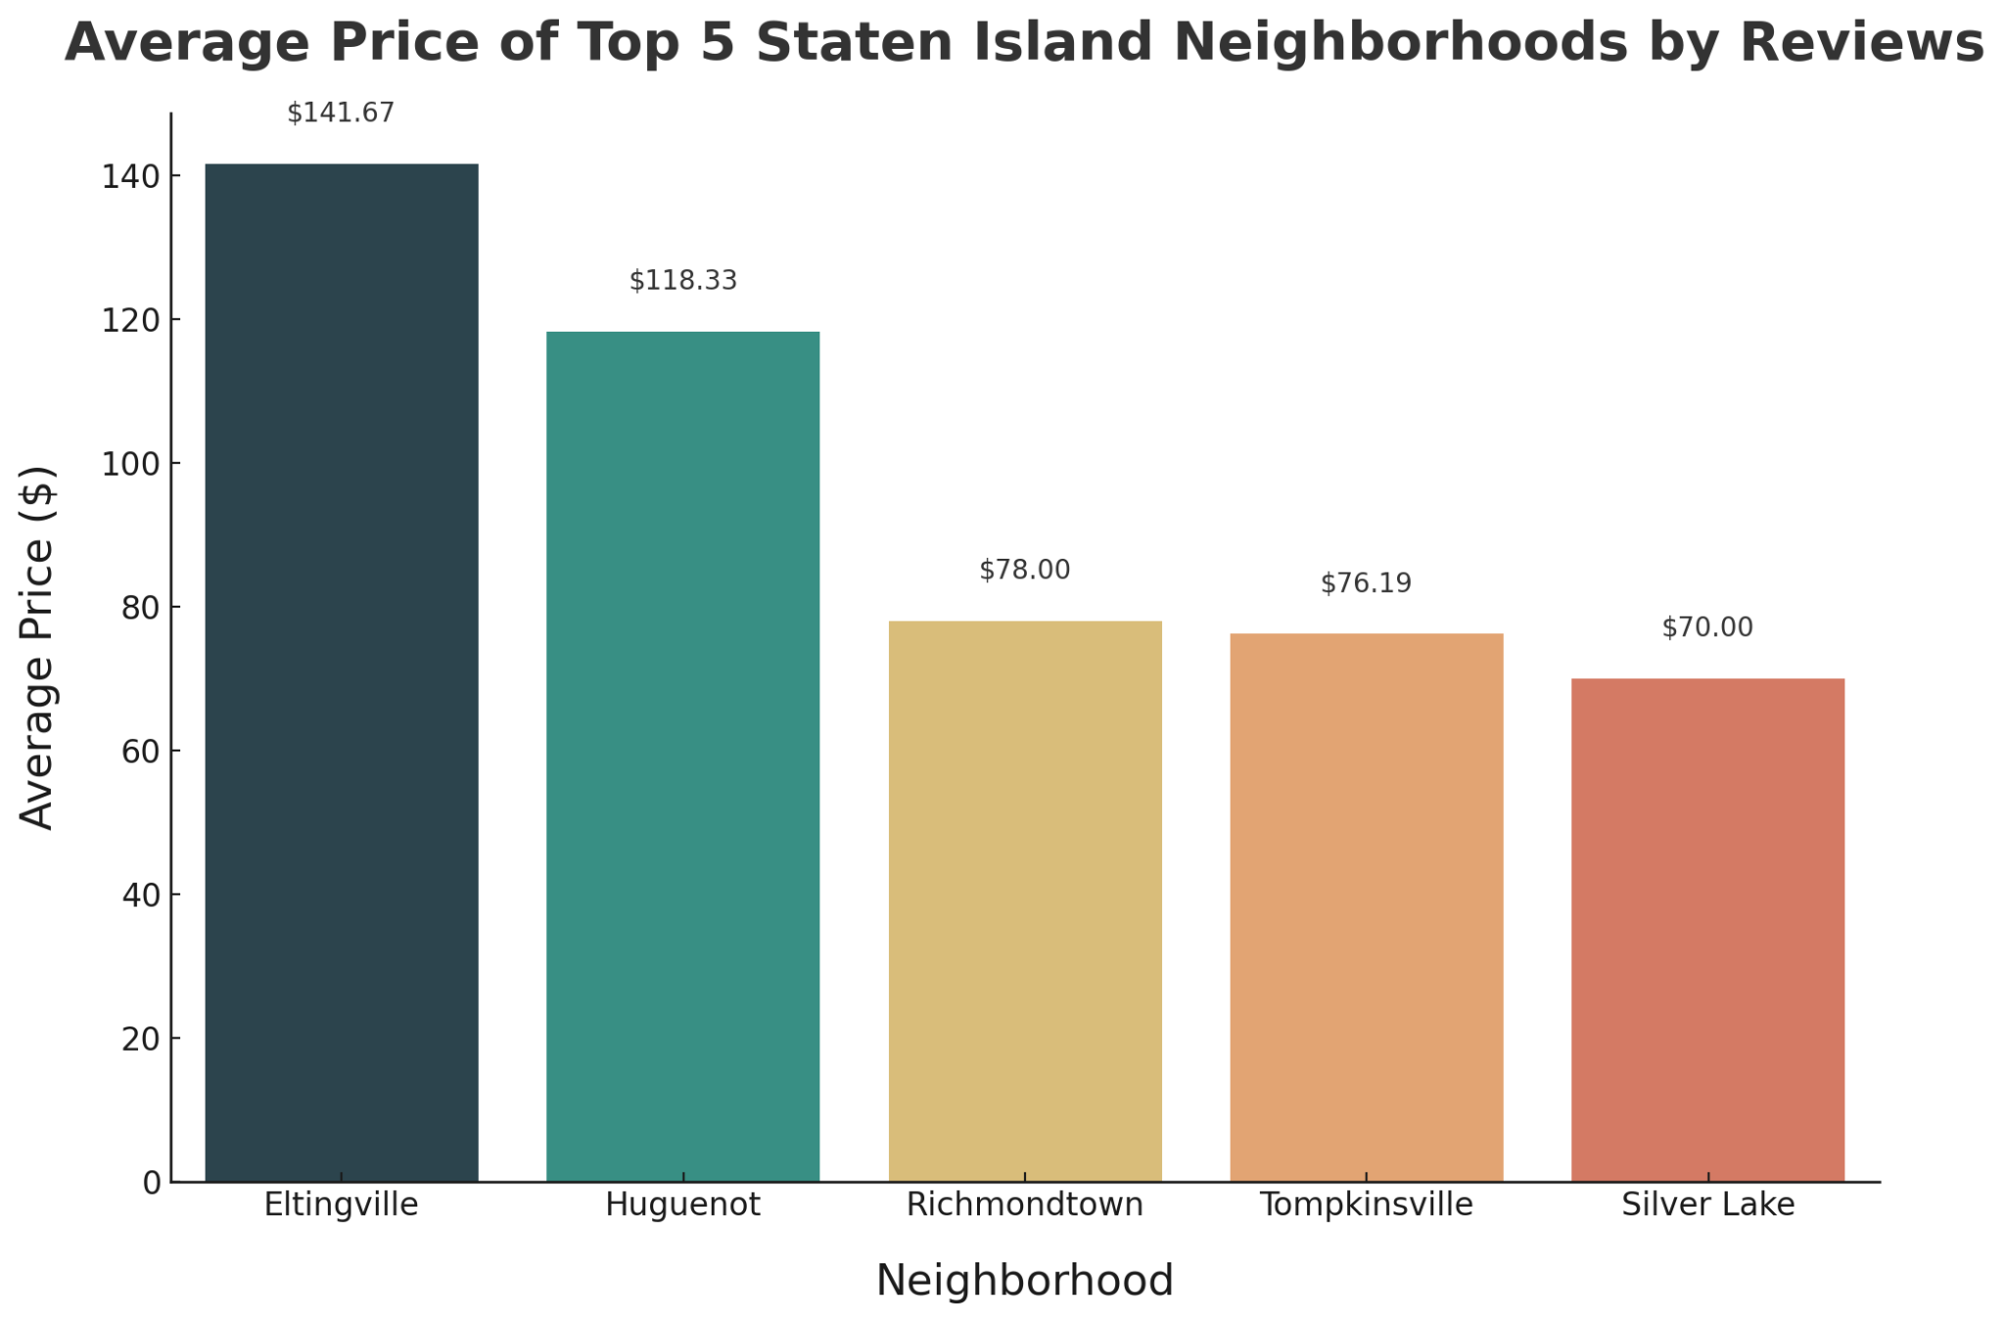
Silver Lake Listings Have the Least Average Price in Staten Island at $70

Slide 24

Minimum Nights Analysis

Slide 25
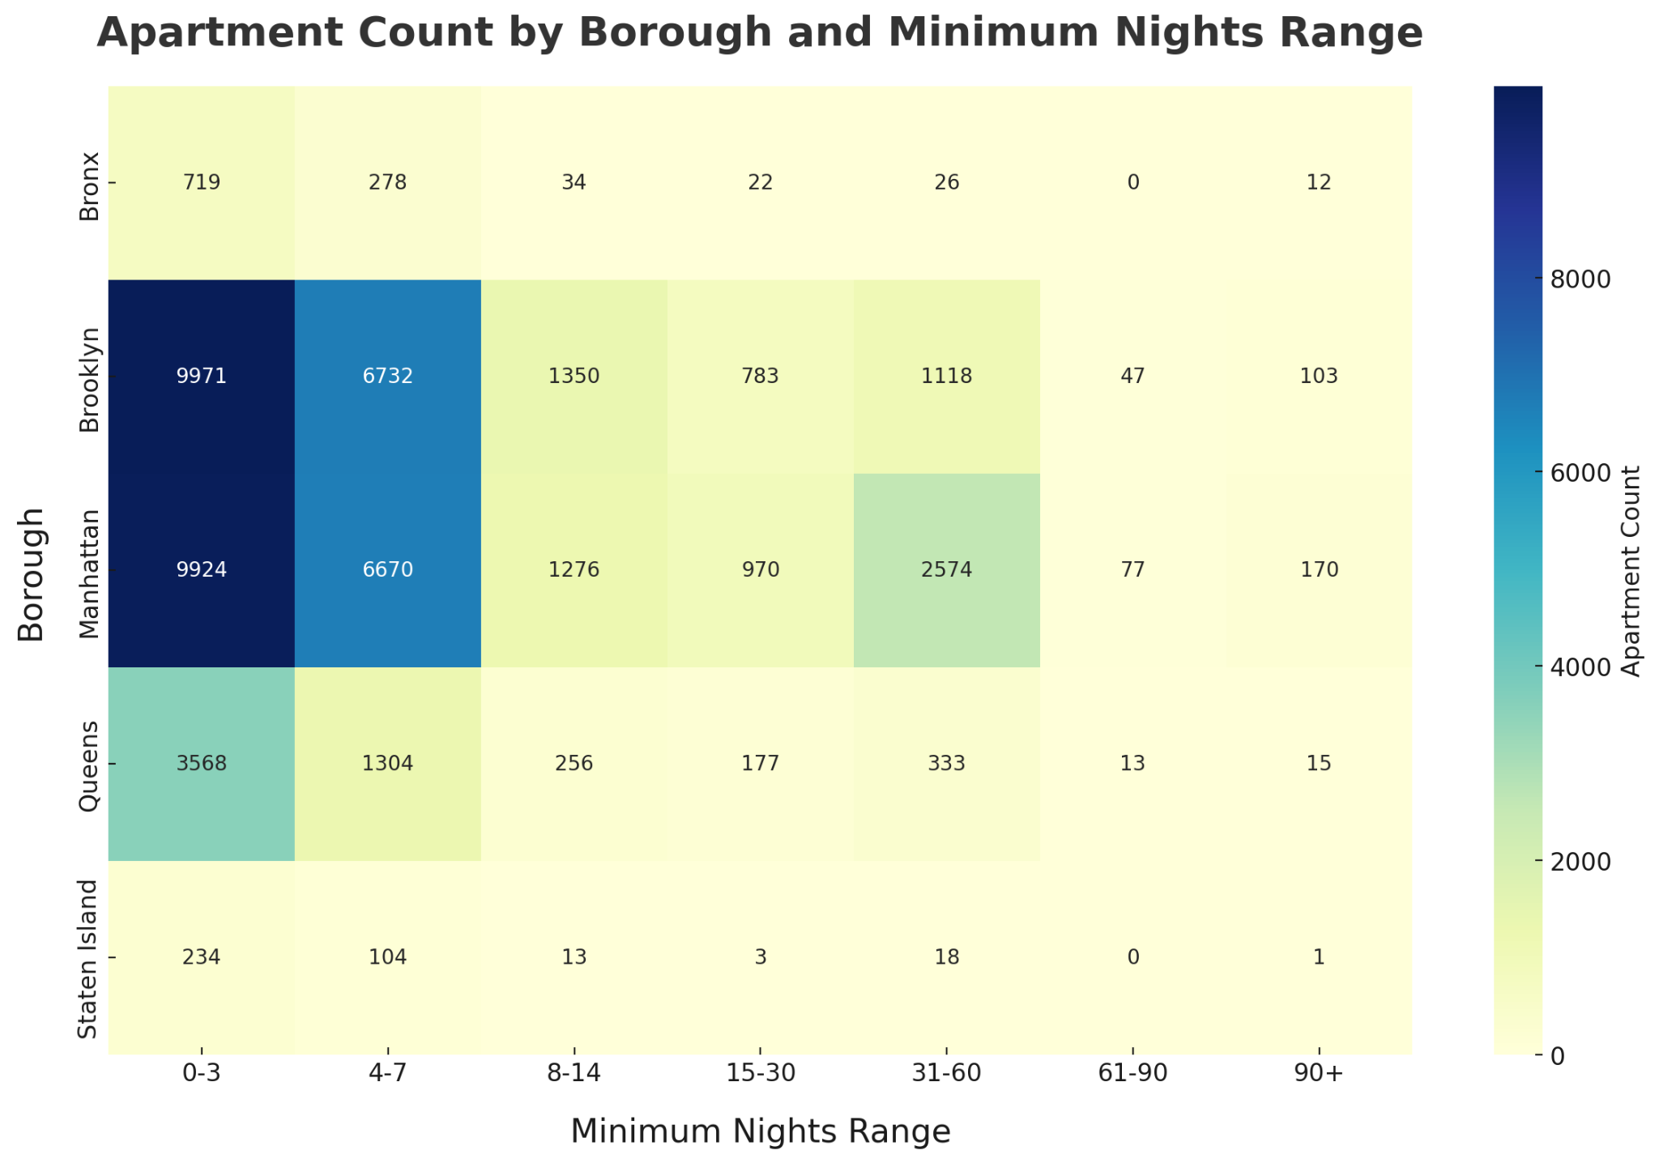
Brooklyn and Manhattan Dominate Short-Term Apartment Listings

Slide 26
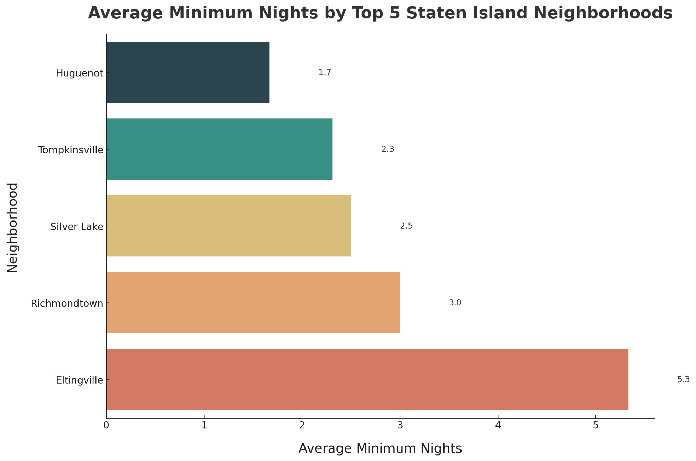
Silver Lake Falls Within (0-3) Average Minimum Nights

Slide 27
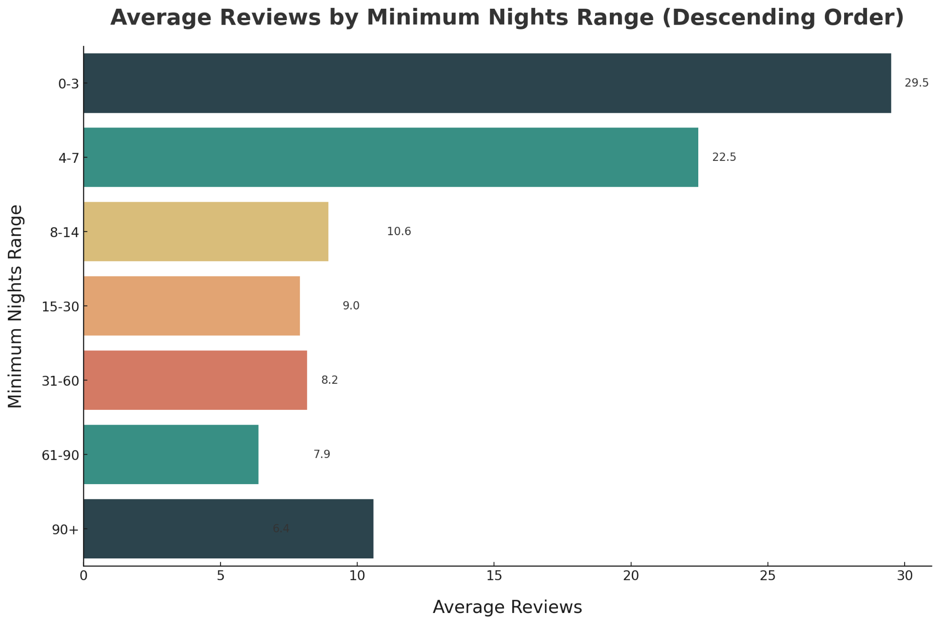
Shorter Stays (0-3 days) Drive Higher Review Engagement
9.6
11.2

Slide 28

Limitations

Slide 29
Limitations
NYC-Specific Data
Static Dataset
Review Bias
Price Vs. Popularity

Slide 30

Summary

Slide 31
Summary
What Makes an Airbnb Popular?
Data Set

Slide 32
Summary
What Makes an Airbnb Popular?
Data Set
Location

Slide 33
Summary
What Makes an Airbnb Popular?
Data Set
Location
Room Type

Slide 34
Summary
What Makes an Airbnb Popular?
Data Set
Location
Room Type
Minimum Nights

Slide 35
Summary
What Makes an Airbnb Popular?
Data Set
Location
Room Type
Minimum Nights
Price

Slide 36
Summary
What Makes an Airbnb Popular?
Data Set
Location
Room Type
Minimum Nights
Price
Kaggle

Slide 37
Summary
What Makes an Airbnb Popular?
Data Set
Location
Room Type
Minimum Nights
Price
Kaggle
2000+ Rows

Slide 38
Summary
What Makes an Airbnb Popular?
Data Set
Location
Room Type
Minimum Nights
Price
Kaggle
2000+ Rows
15 Variables

Slide 39
Summary
What Makes an Airbnb Popular?
Data Set
Location
Room Type
Minimum Nights
Price
Kaggle
Manhattan
Brooklyn
2000+ Rows
15 Variables

Slide 40
Summary
What Makes an Airbnb Popular?
Data Set
Location
Room Type
Minimum Nights
Price
Kaggle
Manhattan
Brooklyn
2000+ Rows
Staten Island
15 Variables

Slide 41
Summary
What Makes an Airbnb Popular?
Data Set
Location
Room Type
Minimum Nights
Price
Kaggle
Manhattan
Brooklyn
2000+ Rows
Staten Island
15 Variables
Silver Lake

Slide 42
Summary
What Makes an Airbnb Popular?
Data Set
Location
Room Type
Minimum Nights
Price
Kaggle
Manhattan
Brooklyn
Entire/Private/
Shared
2000+ Rows
Staten Island
15 Variables
Silver Lake

Slide 43
Summary
What Makes an Airbnb Popular?
Data Set
Location
Room Type
Minimum Nights
Price
Kaggle
Manhattan
Brooklyn
Entire/Private/
Shared
2000+ Rows
Staten Island
Entire/Private
15 Variables
Silver Lake

Slide 44
Summary
What Makes an Airbnb Popular?
Data Set
Location
Room Type
Minimum Nights
Price
Kaggle
Manhattan
Brooklyn
Entire/Private/
Shared
9 Thresholds
2000+ Rows
Staten Island
Entire/Private
15 Variables
Silver Lake

Slide 45
Summary
What Makes an Airbnb Popular?
Data Set
Location
Room Type
Minimum Nights
Price
Kaggle
Manhattan
Brooklyn
Entire/Private/
Shared
9 Thresholds
2000+ Rows
Staten Island
Entire/Private
0-3
15 Variables
Silver Lake

Slide 46
Summary
What Makes an Airbnb Popular?
Data Set
Location
Room Type
Minimum Nights
Price
Kaggle
Manhattan
Brooklyn
Entire/Private/
Shared
9 Thresholds
4 Thresholds
2000+ Rows
Staten Island
Entire/Private
0-3
15 Variables
Silver Lake

Slide 47
Summary
What Makes an Airbnb Popular?
Data Set
Location
Room Type
Minimum Nights
Price
Kaggle
Manhattan
Brooklyn
Entire/Private/
Shared
9 Thresholds
4 Thresholds
2000+ Rows
Staten Island
Entire/Private
0-3
$0-100
15 Variables
Silver Lake

Slide 48

Recommendations

Slide 49

RECOMMENDATIONS
Hosts
Target Silver Lake

Slide 50

RECOMMENDATIONS
Hosts
Airbnb
Enhance visibility of low cost areas
Target Silver Lake

Slide 51

RECOMMENDATIONS
Hosts
Airbnb
Guests
Enhance visibility of low cost areas
Lookout for areas with high reviews
Target Silver Lake

Slide 52
Key Features of Airbnb
Listings in NYC
What Makes an Airbnb More Popular?
Heather He | zhe38@simon.rochester.edu
Godwin Silayo | gsilayo_simon@simon.rochester.edu
Muhammad Zohaib Bin Jamil | mjamil2@simon.rochester.edu
Simon Business School

Slide 53
CODE
The following google drive contains the .ipynb file for this project (Accessible to all with link)
https://drive.google.com/drive/folders/1ILHJF4su-pUGVQKGP7gdnxP2FS3Be-J-?usp=drive_link

